Slide 1
Introduction to Computer Organisation and Architecture
Lecture 6
Cache Memory

Slide 2
Characteristics
Location
Capacity
Unit of transfer
Access method
Performance
Physical type
Physical characteristics
Organisation

Slide 3
Location
CPU
Internal
External

Slide 4
Capacity
Word size
The natural unit of organisation
Number of words
or Bytes

Slide 5
Unit of Transfer
Internal
Usually governed by data bus width
External
Usually a block which is much larger than a word
Addressable unit
Smallest location which can be uniquely addressed
Word internally
Cluster on M$ disks

Slide 6
Characteristics
Location
Refers to whether memory is internal and external to the computer
Internal memory is often equated with main memory
Processor requires its own local memory, in the form of registers
Cache is another form of internal memory
External memory consists of peripheral storage devices that are
accessible to the processor via I/O controllers
Capacity
Memory is typically expressed in terms of bytes
Unit of transfer
For internal memory the unit of transfer is equal to the number of
electrical lines into and out of the memory module

Slide 7
Access Methods (1)
Sequential
Start at the beginning and read through in order
Access time depends on location of data and previous location
e.g. tape
Direct
Individual blocks have unique address
Access is by jumping to vicinity plus sequential search
Access time depends on location and previous location
e.g. disk

Slide 8
Access Methods (2)
Random
Individual addresses identify locations exactly
Access time is independent of location or previous access
e.g. RAM
Associative
Data is located by a comparison with contents of a portion of the store
Access time is independent of location or previous access
e.g. cache

Slide 9
Memory Hierarchy
Registers
In CPU
Internal or Main memory
May include one or more levels of cache
“RAM”
External memory
Backing store

Slide 10
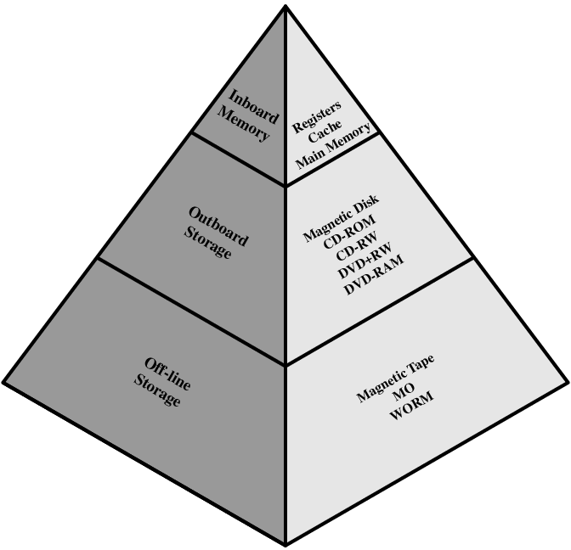
Memory Hierarchy - Diagram

Slide 11
Performance
Access time
Time between presenting the address and getting the valid data
Memory Cycle time
Time may be required for the memory to “recover” before next access
Cycle time is access + recovery
Transfer Rate
Rate at which data can be moved

Slide 12
Physical Types
Semiconductor
RAM
Magnetic
Disk & Tape
Optical
CD & DVD
Others
Bubble
Hologram

Slide 13
Physical Characteristics
Decay
Volatility
Erasable
Power consumption

Slide 14
Organisation
Physical arrangement of bits into words
Not always obvious
e.g. interleaved

Slide 15
The Bottom Line
How much?
Capacity
How fast?
Time is money
How expensive?

Slide 16
Hierarchy List
Registers
L1 Cache
L2 Cache
Main memory
Disk cache
Disk
Optical
Tape

Slide 17
So you want fast?
It is possible to build a computer which uses only static RAM (see later)
This would be very fast
This would need no cache
How can you cache cache?
This would cost a very large amount

Slide 18
Locality of Reference
During the course of the execution of a program, memory references tend to cluster
e.g. loops
Decreasing cost per bit
Increasing capacity
Increasing access time
Decreasing frequency of access of the memory by the processor

Slide 19
Cache
Small amount of fast memory
Sits between normal main memory and CPU
May be located on CPU chip or module
The use of two levels of memory to reduce average access time works in principle

Slide 20
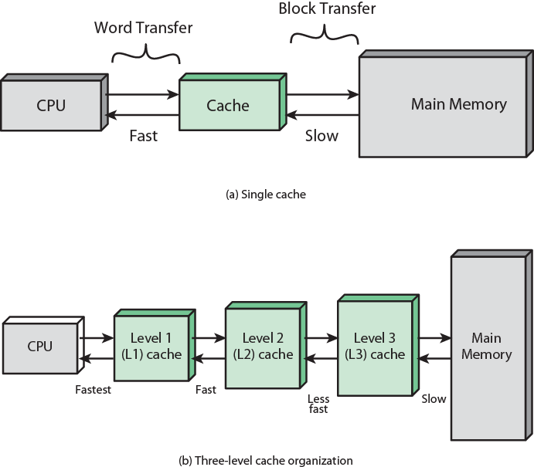
Cache and Main Memory

Slide 21
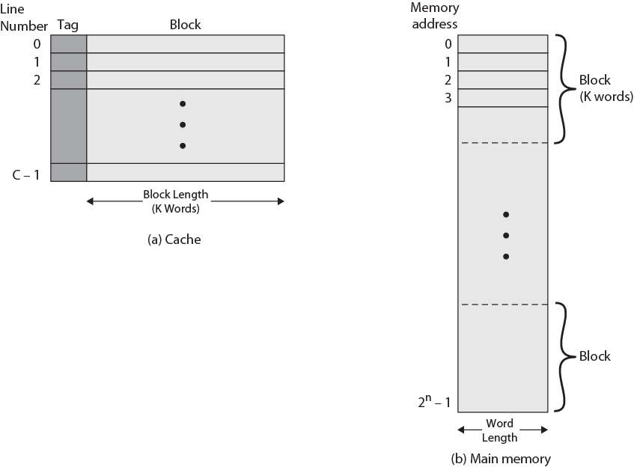
Cache/Main Memory Structure

Slide 22
Cache operation – overview
CPU requests contents of memory location
Check cache for this data
If present, get from cache (fast)
If not present, read required block from main memory to cache
Then deliver from cache to CPU
Cache includes tags to identify which block of main memory is in each cache slot

Slide 23
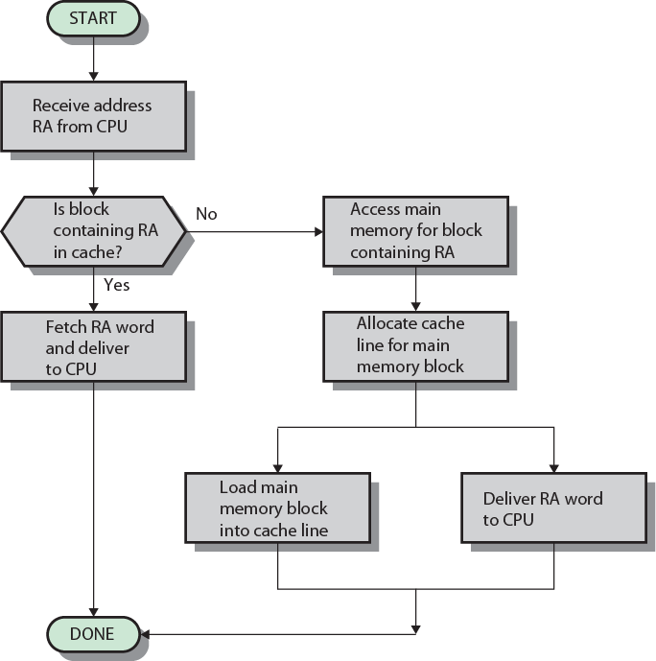
Cache Read Operation - Flowchart

Slide 24
Cache Design
Addressing
Size
Mapping Function
Replacement Algorithm
Write Policy
Block Size
Number of Caches

Slide 25
Cache Addressing
Where does cache sit?
Between processor and virtual memory management unit
Between MMU and main memory
Logical cache (virtual cache) stores data using virtual addresses
Processor accesses cache directly, not thorough physical cache
Cache access faster, before MMU address translation
Virtual addresses use same address space for different applications
Must flush cache on each context switch
Physical cache stores data using main memory physical addresses

Slide 26
Size does matter
Cost
More cache is expensive
Speed
More cache is faster (up to a point)
Checking cache for data takes time

Slide 27
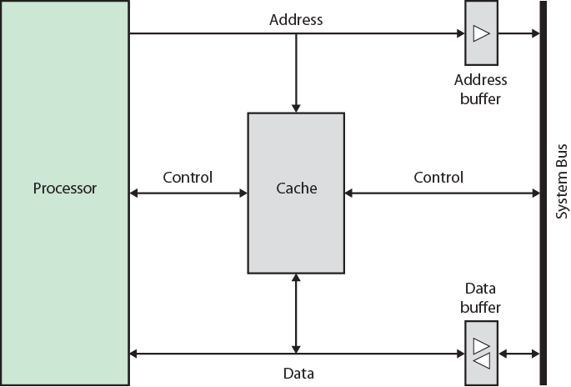
Typical Cache Organization

Slide 28
Comparison of Cache Sizes
Processor
Type
Year of Introduction
L1 cache
L2 cache
L3 cache
PDP-11/70
Minicomputer
1975
1 KB
—
—
VAX 11/780
Minicomputer
1978
16 KB
—
—
IBM 3033
Mainframe
1978
64 KB
—
—
IBM 3090
Mainframe
1985
128 to 256 KB
—
—
Intel 80486
PC
1989
8 KB
—
—
Pentium
PC
1993
8 KB/8 KB
256 to 512 KB
—
PowerPC 601
PC
1993
32 KB
—
—
PowerPC 620
PC
1996
32 KB/32 KB
—
—
PowerPC G4
PC/server
1999
32 KB/32 KB
256 KB to 1 MB
2 MB
IBM S/390 G4
Mainframe
1997
32 KB
256 KB
2 MB
IBM S/390 G6
Mainframe
1999
256 KB
8 MB
—
Pentium 4
PC/server
2000
8 KB/8 KB
256 KB
—
IBM SP
High-end server/ supercomputer
2000
64 KB/32 KB
8 MB
—
CRAY MTAb
Supercomputer
2000
8 KB
2 MB
—
Itanium
PC/server
2001
16 KB/16 KB
96 KB
4 MB
SGI Origin 2001
High-end server
2001
32 KB/32 KB
4 MB
—
Itanium 2
PC/server
2002
32 KB
256 KB
6 MB
IBM POWER5
High-end server
2003
64 KB
1.9 MB
36 MB
CRAY XD-1
Supercomputer
2004
64 KB/64 KB
1MB
—
IBM POWER6
PC/server
2007
64 KB/64 KB
4 MB
32 MB
IBM Z10
Mainframe
2008
64 KB/128 KB
3 MB
24-48 MB
Intel Core i7 EE 990
Workstation/Server
2011
6 x 32 KB/32 KB
1.5 MB
12 MB

Slide 29
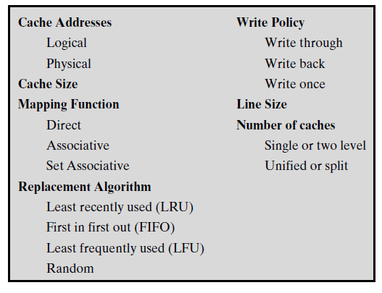
Elements of Cache Design

Slide 30
Mapping Function
Cache of 64kByte
Cache block of 4 bytes
i.e. cache is 16k (2¹⁴) lines of 4 bytes
16MBytes main memory
24 bit address
(2²⁴=16M)

Slide 31
Direct Mapping
Each block of main memory maps to only one cache line
i.e. if a block is in cache, it must be in one specific place
Address is in two parts
Least Significant w bits identify unique word
Most Significant s bits specify one memory block
The MSBs are split into a cache line field r and a tag of s-r (most significant)

Slide 32
Direct Mapping Address Structure
Tag s-r
Line or Slot r
Word w
8
14
2
24 bit address
2 bit word identifier (4 byte block)
22 bit block identifier
8 bit tag (=22-14)
14 bit slot or line
No two blocks in the same line have the same Tag field
Check contents of cache by finding line and checking Tag

Slide 33
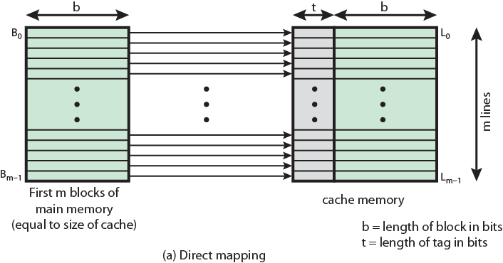
Direct Mapping from Cache to Main Memory

Slide 34
Direct Mapping Cache Line Table
Cache line | Main Memory blocks held
0 | 0, m, 2m, 3m…2s-m
1 | 1,m+1, 2m+1…2s-m+1
…
m-1 | m-1, 2m-1,3m-1…2s-1

Slide 35
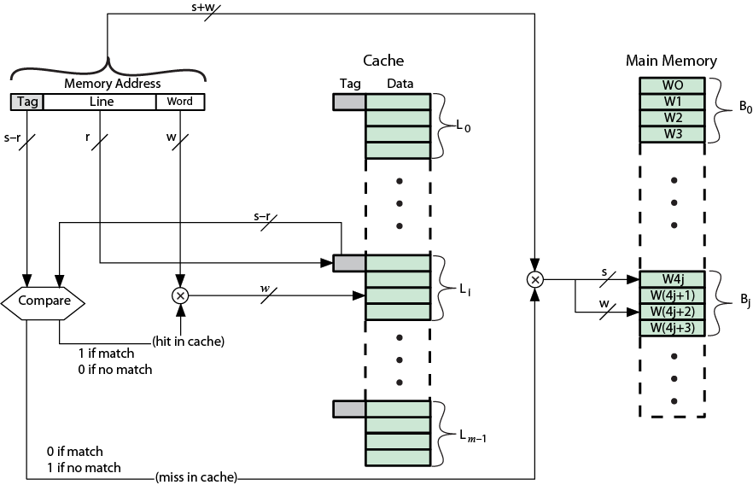
Direct Mapping Cache Organization

Slide 36
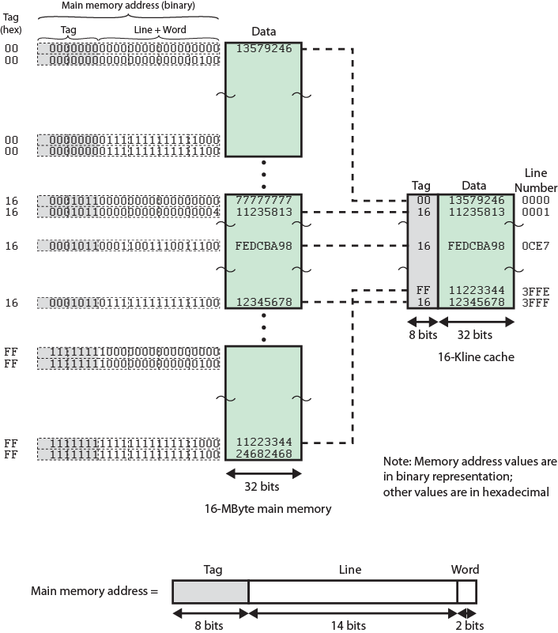
Direct Mapping Example

Slide 37
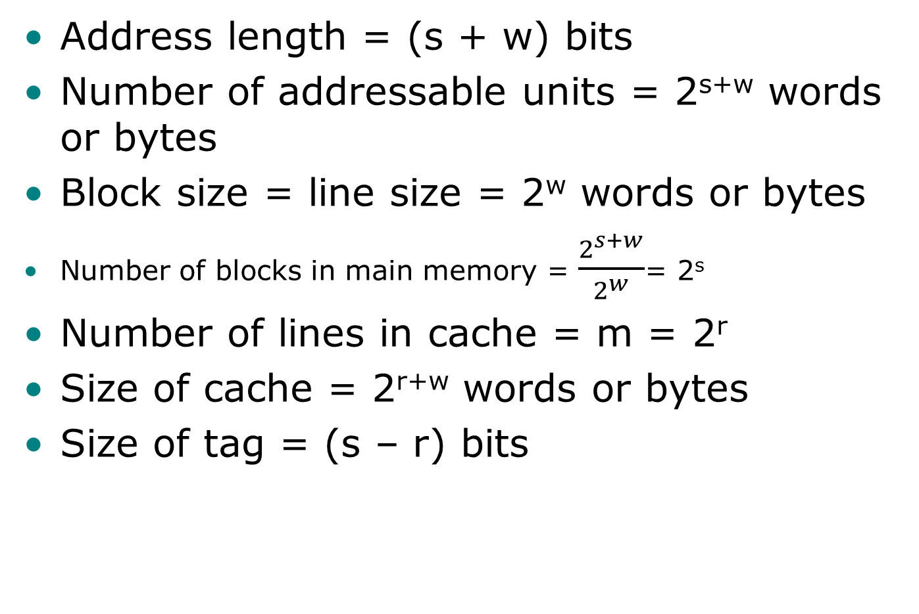
Direct Mapping Summary
Address length = (s + w) bits
Number of addressable units = 2^{s+w} words or bytes
Block size = line size = 2^{w} words or bytes
Number of blocks in main memory = $\frac{2^{s+w}}{2^{w}}$= 2^{s}
Number of lines in cache = m = 2^{r}
Size of cache = 2^{r+w} words or bytes
Size of tag = (s – r) bits

Slide 38
Direct Mapping pros & cons
Simple
Inexpensive
Fixed location for given block
If a program accesses 2 blocks that map to the same line repeatedly, cache misses are very high

Slide 39
Direct Mapping Example
No of cache line =16K
Block size = 1 word
Find the starting memory address for each cache line
Cache line 0
000000, 010000,…,FF0000
Cache line 5?
___________________________________________________

Slide 40
Victim Cache
Lower miss penalty
Remember what was discarded
Already fetched
Use again with little penalty
Fully associative
4 to 16 cache lines
Between direct mapped L1 cache and next memory level

Slide 41
Associative Mapping
A main memory block can load into any line of cache
Memory address is interpreted as tag and word
Tag uniquely identifies block of memory
Every line’s tag is examined for a match
Cache searching gets expensive

Slide 42
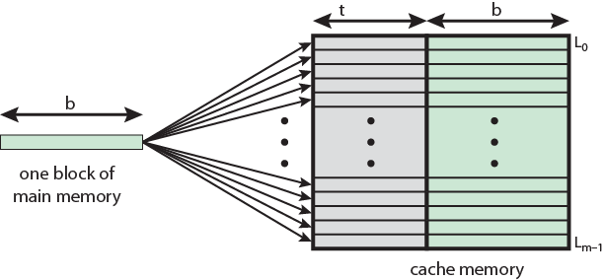
Associative Mapping from Cache to Main Memory

Slide 43
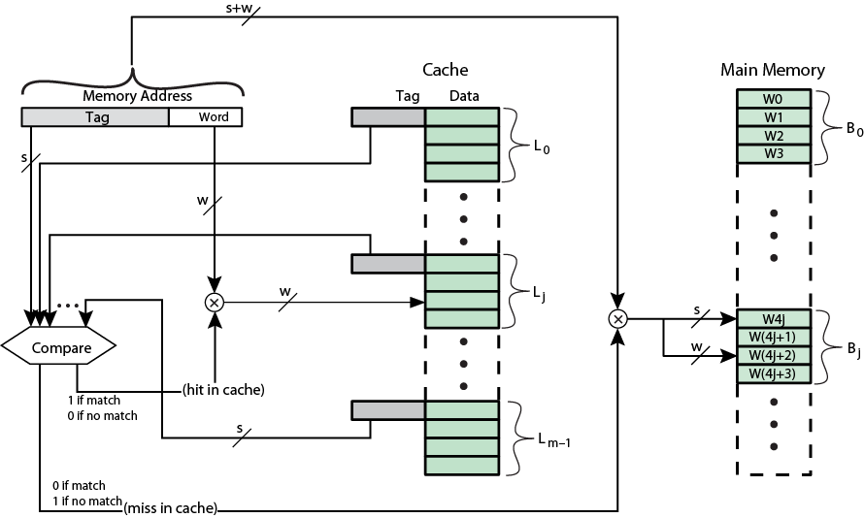
Fully Associative Cache Organization

Slide 44
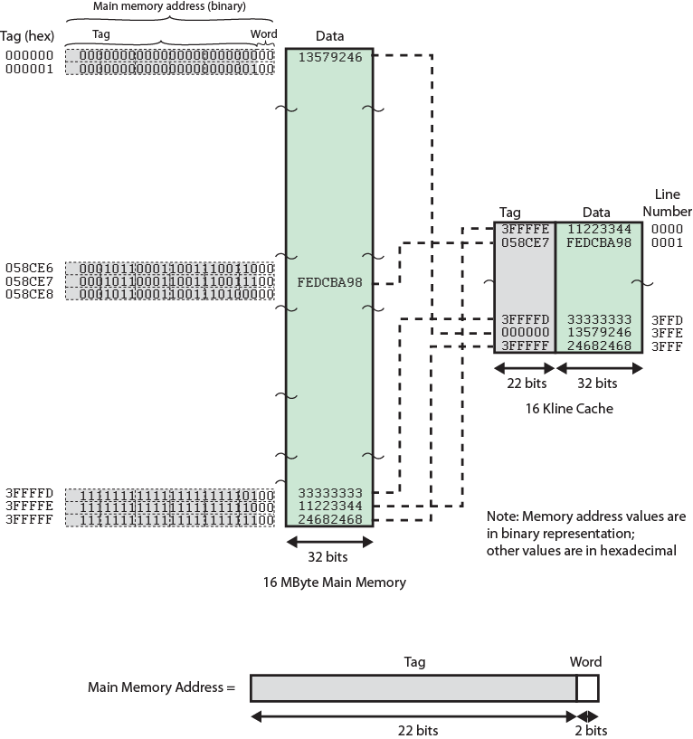
Associative Mapping Example

Slide 45
Associative Mapping Address Structure
Word
2 bit
Tag 22 bit
22 bit tag stored with each 32 bit block of data
Compare tag field with tag entry in cache to check for hit
Least significant 2 bits of address identify which 16 bit word is required from 32 bit data block
e.g.
Address Tag Data Cache line
FFFFFC FFFFFC 24682468 3FFF

Slide 46
Associative Mapping Summary
Address length = (s + w) bits
Number of addressable units = 2^{s+w} words or bytes
Block size = line size = 2^{w} words or bytes
Number of blocks in main memory = ^{2s+ w}/2^{w} = 2^{s}
Number of lines in cache = undetermined
Size of tag = s bits

Slide 47
Set Associative Mapping
Cache is divided into a number of sets
Each set contains a number of lines
A given block maps to any line in a given set
e.g. Block B can be in any line of set i
e.g. 2 lines per set
2 way associative mapping
A given block can be in one of 2 lines in only one set

Slide 48
Set Associative Mapping Example
13 bit set number
Block number in main memory is modulo 2¹³
000000, 00A000, 00B000, 00C000 … map to same set

Slide 49
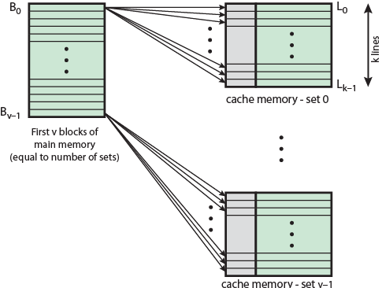
Mapping From Main Memory to Cache: v Associative

Slide 50
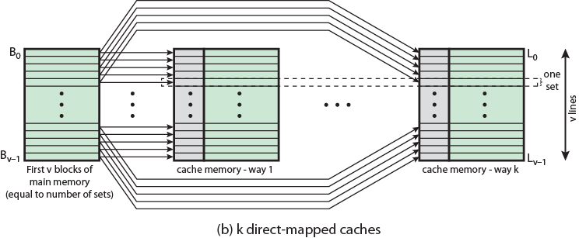
Mapping From Main Memory to Cache: k-way Associative

Slide 51
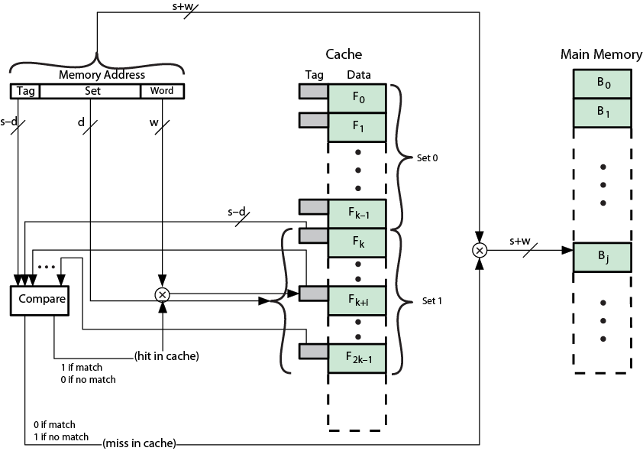
K-Way Set Associative Cache Organization

Slide 52
Set Associative Mapping Address Structure
Word
2 bit
Tag 9 bit
Set 13 bit
Use set field to determine cache set to look in
Compare tag field to see if we have a hit
e.g
Address Tag Data Set number
1FF 7FFC 1FF 12345678 1FFF
001 7FFC 001 11223344 1FFF

Slide 53
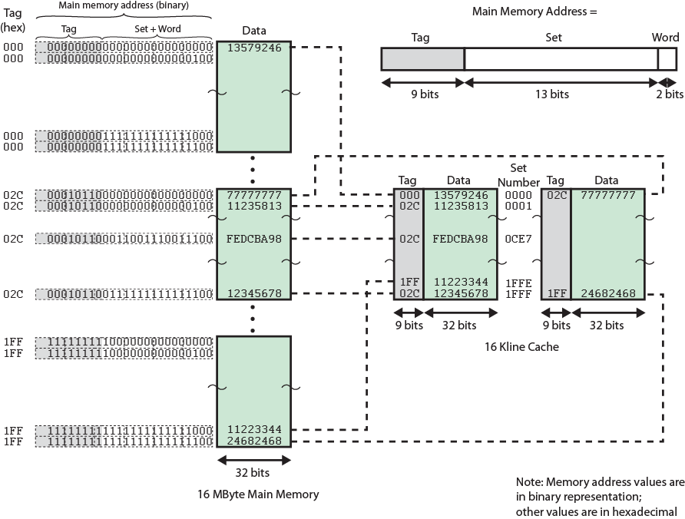
Two Way Set Associative Mapping Example

Slide 54
Set Associative Mapping Summary
Address length = (s + w) bits
Number of addressable units = 2^{s+w} words or bytes
Block size = line size = 2^{w} words or bytes
Number of blocks in main memory = 2^{d}
Number of lines in set = k
Number of sets = v = 2^{d}
Number of lines in cache = kv = k * 2^{d}
Size of tag = (s – d) bits

Slide 55
Direct and Set Associative Cache Performance Differences
Significant up to at least 64kB for 2-way
Difference between 2-way and 4-way at 4kB much less than 4kB to 8kB
Cache complexity increases with associativity
Not justified against increasing cache to 8kB or 16kB
Above 32kB gives no improvement
(simulation results)

Slide 56
Figure 4.16 Varying Associativity over Cache Size

Slide 57
Replacement Algorithms (1) Direct mapping
No choice
Each block only maps to one line
Replace that line

Slide 58
Replacement Algorithms (2) Associative & Set Associative
Hardware implemented algorithm (speed)
Least Recently used (LRU)
e.g. in 2 way set associative
Which of the 2 block is lru?
First in first out (FIFO)
replace block that has been in cache longest
Least frequently used
replace block which has had fewest hits
Random

Slide 59
Write Policy
Must not overwrite a cache block unless main memory is up to date
Multiple CPUs may have individual caches
I/O may address main memory directly

Slide 60
Write through
All writes go to main memory as well as cache
Multiple CPUs can monitor main memory traffic to keep local (to CPU) cache up to date
Lots of traffic
Slows down writes
Remember bogus write through caches!

Slide 61
Write back
Updates initially made in cache only
Update bit for cache slot is set when update occurs
If block is to be replaced, write to main memory only if update bit is set
Other caches get out of sync
I/O must access main memory through cache
N.B. 15% of memory references are writes

Slide 62
Line Size
Retrieve not only desired word but a number of adjacent words as well
Increased block size will increase hit ratio at first
the principle of locality
Hit ratio will decreases as block becomes even bigger
Probability of using newly fetched information becomes less than probability of reusing replaced
Larger blocks
Reduce number of blocks that fit in cache
Data overwritten shortly after being fetched
Each additional word is less local so less likely to be needed
No definitive optimum value has been found
8 to 64 bytes seems reasonable
For HPC systems, 64- and 128-byte most common

Slide 63
Multilevel Caches
High logic density enables caches on chip
Faster than bus access
Frees bus for other transfers
Common to use both on and off chip cache
L1 on chip, L2 off chip in static RAM
L2 access much faster than DRAM or ROM
L2 often uses separate data path
L2 may now be on chip
Resulting in L3 cache
Bus access or now on chip…

Slide 64
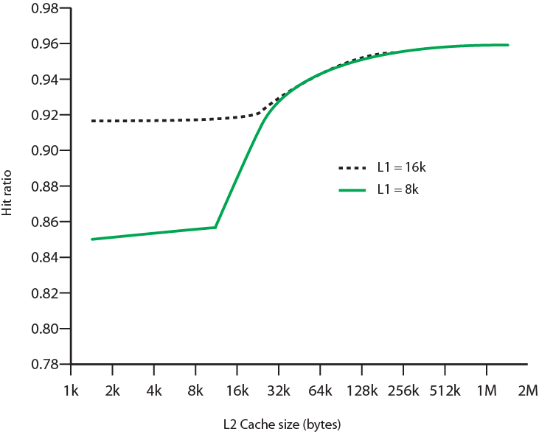
Hit Ratio (L1 & L2) For 8 kbytes and 16 kbyte L1

Slide 65
Unified v Split Caches
One cache for data and instructions or two, one for data and one for instructions
Advantages of unified cache
Higher hit rate
Balances load of instruction and data fetch
Only one cache to design & implement
Advantages of split cache
Eliminates cache contention between instruction fetch/decode unit and execution unit
Important in pipelining

Slide 66
Pentium 4 Cache
80386 – no on chip cache
80486 – 8k using 16 byte lines and four way set associative organization
Pentium (all versions) – two on chip L1 caches
Data & instructions
Pentium III – L3 cache added off chip
Pentium 4
L1 caches
8k bytes
64 byte lines
four way set associative
L2 cache
Feeding both L1 caches
256k
128 byte lines
8 way set associative
L3 cache on chip

Slide 67
Intel Cache Evolution
Problem
Solution
Processor on which feature first appears
External memory slower than the system bus.
Add external cache using faster memory technology.
386
Increased processor speed results in external bus becoming a bottleneck for cache access.
Move external cache on-chip, operating at the same speed as the processor.
486
Internal cache is rather small, due to limited space on chip
Add external L2 cache using faster technology than main memory
486
Contention occurs when both the Instruction Prefetcher and the Execution Unit simultaneously require access to the cache. In that case, the Prefetcher is stalled while the Execution Unit’s data access takes place.
Create separate data and instruction caches.
Pentium
Increased processor speed results in external bus becoming a bottleneck for L2 cache access.
Create separate back-side bus that runs at higher speed than the main (front-side) external bus. The BSB is dedicated to the L2 cache.
Pentium Pro
Move L2 cache on to the processor chip.
Pentium II
Some applications deal with massive databases and must have rapid access to large amounts of data. The on-chip caches are too small.
Add external L3 cache.
Pentium III
Move L3 cache on-chip.
Pentium 4

Slide 68
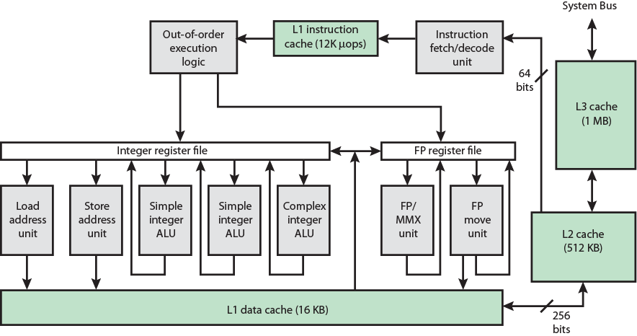
Pentium 4 Block Diagram

Slide 69
Pentium 4 Core Processor
Fetch/Decode Unit
Fetches instructions from L2 cache
Decode into micro-ops
Store micro-ops in L1 cache
Out of order execution logic
Schedules micro-ops
Based on data dependence and resources
May speculatively execute
Execution units
Execute micro-ops
Data from L1 cache
Results in registers
Memory subsystem
L2 cache and systems bus

Slide 70
Pentium 4 Design Reasoning
Decodes instructions into RISC like micro-ops before L1 cache
Micro-ops fixed length
Superscalar pipelining and scheduling
Pentium instructions long & complex
Performance improved by separating decoding from scheduling & pipelining
(More later – ch14)
Data cache is write back
Can be configured to write through
L1 cache controlled by 2 bits in register
CD = cache disable
NW = not write through
2 instructions to invalidate (flush) cache and write back then invalidate
L2 and L3 8-way set-associative
Line size 128 bytes

Slide 71
ARM Cache Features
Core | Cache Type | Cache Size (kB) | Cache Line Size (words) | Associativity | Location | Write Buffer Size (words)
ARM720T | Unified | 8 | 4 | 4-way | Logical | 8
ARM920T | Split | 16/16 D/I | 8 | 64-way | Logical | 16
ARM926EJ-S | Split | 4-128/4-128 D/I | 8 | 4-way | Logical | 16
ARM1022E | Split | 16/16 D/I | 8 | 64-way | Logical | 16
ARM1026EJ-S | Split | 4-128/4-128 D/I | 8 | 4-way | Logical | 8
Intel StrongARM | Split | 16/16 D/I | 4 | 32-way | Logical | 32
Intel Xscale | Split | 32/32 D/I | 8 | 32-way | Logical | 32
ARM1136-JF-S | Split | 4-64/4-64 D/I | 8 | 4-way | Physical | 32

Slide 72
ARM Cache Organization
Small FIFO write buffer
Enhances memory write performance
Between cache and main memory
Small c.f. cache
Data put in write buffer at processor clock speed
Processor continues execution
External write in parallel until empty
If buffer full, processor stalls
Data in write buffer not available until written
So keep buffer small

Slide 73
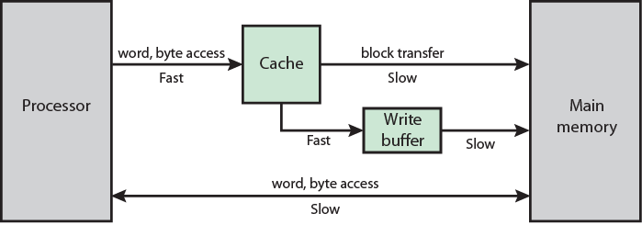
ARM Cache and Write Buffer Organization

Slide 74
Internet Sources
Manufacturer sites
Intel
ARM
Search on cache

